Slide 1
WELCOME TO TEAM QUANTSTRAW
Here we present our project based on a LUDO game!!

Slide 2
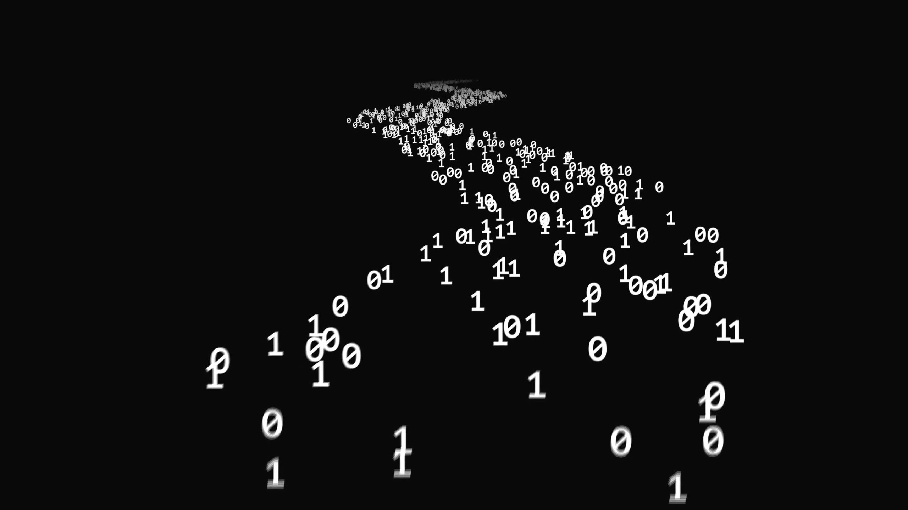
Quantum computing is a revolution in the world of tech. This hackathon allowed us to explore one of its major aspects:” how to generate random numbers in a bit faster way”. LUDO is one of the classic games we all have played, a memory of our childhood. Now to make it a bit quantized we modified the process of producing random numbers by building circuits in Qiskit.

Slide 3
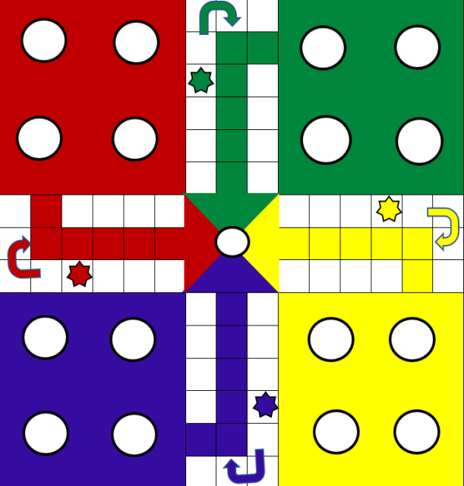
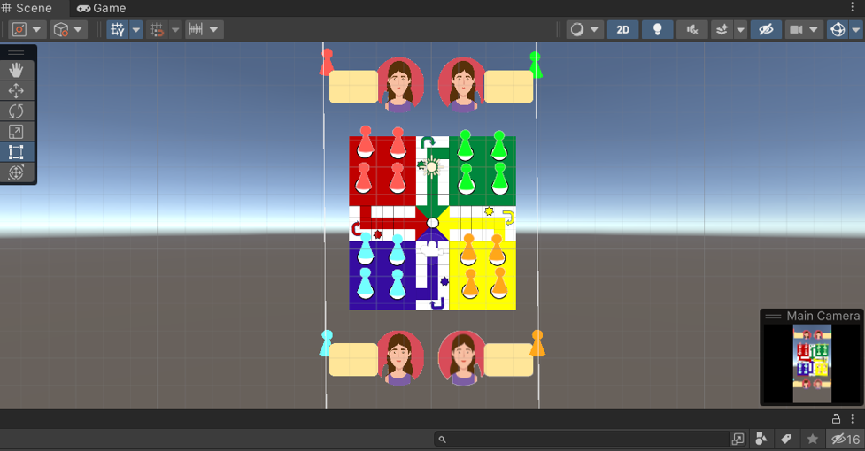
IDEA
LUDO! Let’s play it in our way.
As it is in the classical way, it comprises four players. But for a twist, we have our winner with the most number of sixes. The numbers on the dice are generated for each player using a circuit in Qiskit which we have used as a replacement for the randint function used in python. The main advantage of using this was that we got the numbers at a much faster speed. We have also tried to incorporate this game with an interface built on the game dev app UNITY. We have an objective of moving the pieces in accordance with the random numbers we get from the circuits on the board interface we have designed.Below images are all designed by us!!.

Slide 4

WHAT WE ARE TRYING TO ACHIEVE!
GAMING! One of the largest sectors which require large data sets. To revolutionize this sector we need a faster way to do this.
WELL WELL WELL! Quantum concepts are our answer to this problem.
Taking the example of our game we have just fastened up the process of producing random numbers by using circuits. This concept appears a lil bit insignificant on the ground of four players but on a larger scale where we can have multiple players playing on the same server, this can be a real boon!

Slide 5

Was not a piece of cake for us?
Qiskit, being a total thing for us to explore, gave us many setbacks. Despite brainstorming the logic behind our projects, we could not connect them to our main idea. Collaborating Qiskit with the python language and the linkage with UNITY was the major problem we faced. Due to time constraints, we were unable to work on it, but we as a team are glad that were able to pull it so far.

Slide 6
TEAM MEMBERS!!
1. Srishti Anand(Team Leader)
2. Yash Awasthi
3. Prachi Bahadur Singh
4. Avnish Yadav

Slide 7
Thank You!
Hope you liked our efforts!!

